Slide 1

Data Bootcamp Final Project Presentation
IMPORTANT IMPLICATIONS OF LIFE EXPECTANCY IN DEVELOPING AND DEVELOPED COUNTRIES
OPEYEMI SEYI AWONUGBA

Slide 2

About Me
Educational background: Microbiology, Public health, and Business Administration.
Professional background: Healthcare business development, Organisational performance, and Education.
Area of specialisation: Intersection of healthcare, organisational performance and technology.
Interests: Research, health improvement, healthcare performance, organisational performance, healthcare technology, digital technology.
Notes:
….I am excited about graduating from the Data Analytics boot camp.

Slide 3
My Project - Objectives
This project used the WHO (World Health Organisation) Life expectancy Dataset which focused on immunisation factors, mortality factors, economic factors, social factors and other health related factors from specific developing and developed countries. The following objectives were identified for the project.
To investigate the variation of life expectancy over the years.
To investigate the variation of life expectancy by country status.
To investigate the life expectancy affected by mortality.
To investigate the impact of healthcare expenditure on life expectancy.
To investigate top ten countries with the highest vs lowest life expectancies in 2014.

Slide 4
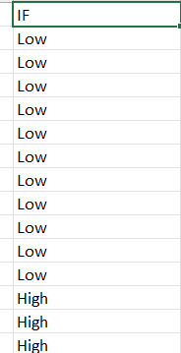
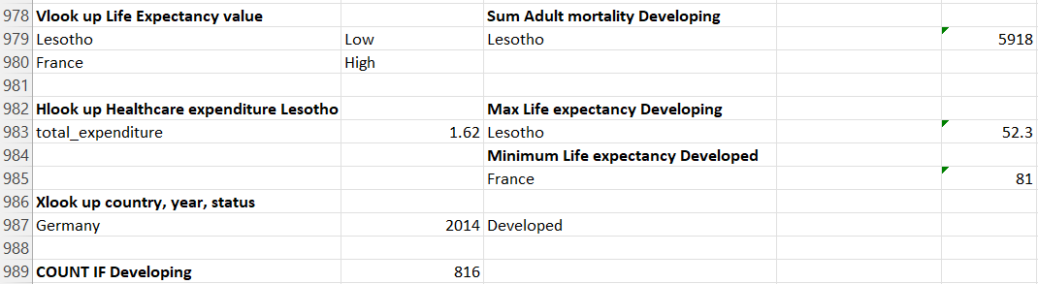
Excel Data Analysis

Slide 5
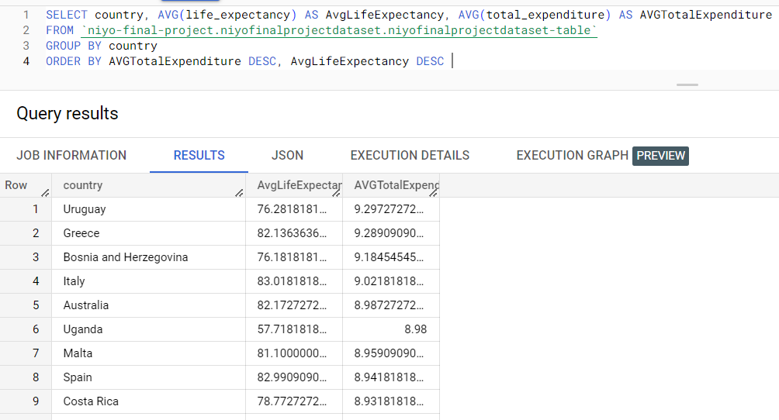
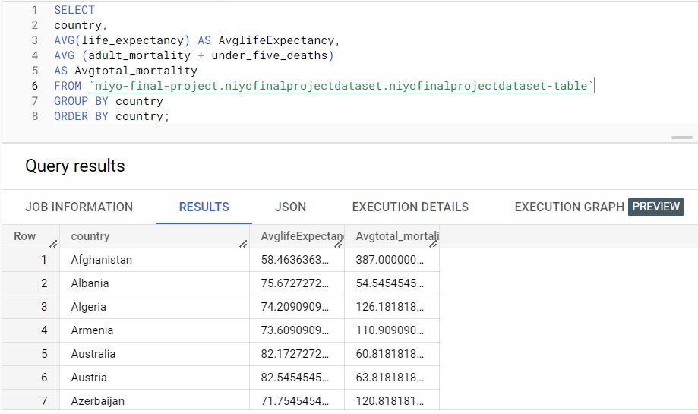
SQL Data Analysis

Slide 6
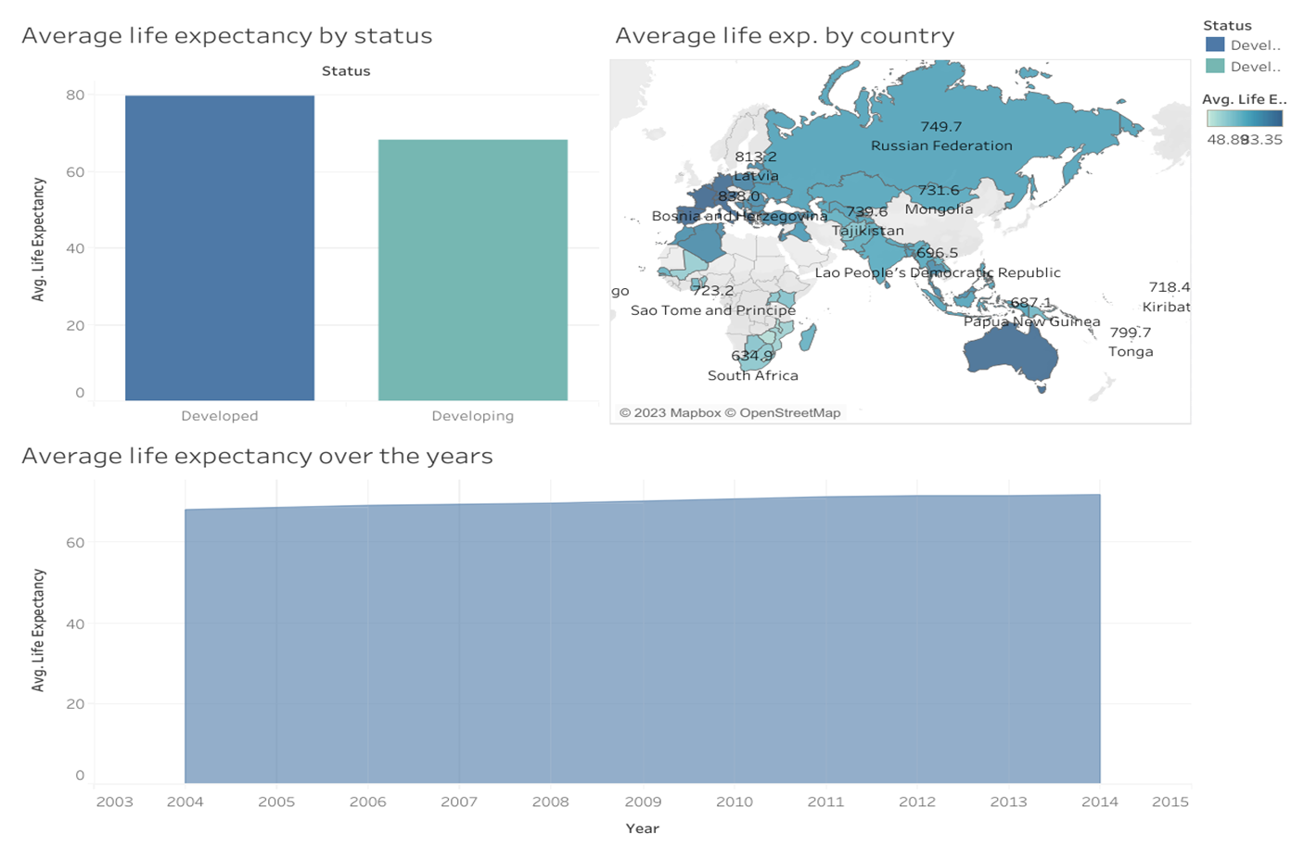
Visualisation using Tableau- Dashboard 1

Slide 7
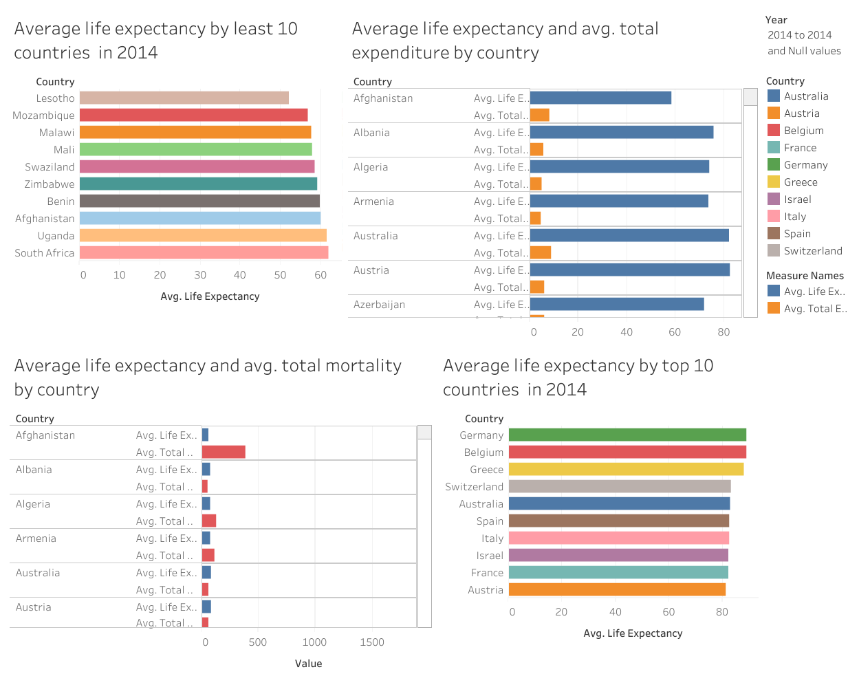
Visualisation using Tableau - Dashboard 2

Slide 8
Results/ Findings
Average life expectancy by status
Average life expectancy is higher in developed countries than in developing countries.
Average life expectancy over the years
Average life expectancy is consistently increasing over the years from 2004 to 2014.
Average life expectancy by country
The map indicates by the darker blue colours and numeric values indicates that Average life expectancy is higher in developed countries than in developing countries.
Countries with highest versus lowest average life expectancies in 2014
In 2014, Germany had the highest average life expectancy while Lesotho had the lowest.
Average life expectancy and average total expenditure by country
Although the Average life expectancy for all countries is consistently higher than total expenditure on healthcare. The life expectancy and total expenditure values are inconsistent across countries as some countries with high average healthcare expenditure have lower life expectancies than other countries with lower healthcare expenditure. Therefore, Average life expectancy appears to be significantly higher in countries with higher average healthcare expenditure (Uruguay, Greece, Bosnia and Herzegovina, Italy, and Australia) than countries with lower healthcare expenditure Bangladesh, Pakistan, Indonesia, Turkmenistan, and Myanmar).
Average life expectancy and average total mortality by country
Average total mortality has been consistently and significantly higher than average life expectancy for all countries analysed. With Tunisia having the lowest average total mortality and India having the highest. While for average life expectancy Lesotho had the lowest and France had the highest. Countries with the lowest average mortalities have the highest average life expectancies while countries with higher average mortalities have lower average life expectancies. Developing and implementing strategies to reduce mortality may result in higher life expectancies for countries with lower life expectancy.

Slide 9



Challenges
The following challenges were encountered.
There were several inconsistencies in the data such as blanks, missing, and incomplete values. Many countries had missing data for some of the years. These were removed during data cleaning to avoid bias. Due to these missing values data for the analysis was limited to years 2004 to 2014.
Importing the file containing the dataset initially gave some problems as the format was not CSV, this problem was solved once the file was converted to CSV format.
Time limitation due to family and new work arrangements.

Slide 10
Conclusion and Key Learnings
Reasons for Data bootcamp: To bridge the gap between theory and practice. To navigate into the technology field. Top 3 key learnings Educationally: Improved digital, data analysis and tech skills in general. Personally: Increased level of motivation and resilience. Career-wise: A more robust understanding on the application of data analysis and tech to healthcare and the general business field was developed. Application and evidence of learning Project management principles were learnt evidenced by planning, designing and implementation this project. SQL and Python were learnt for data analysis: evidenced by the application of SQL to analyse the raw data for reduced complexity. Tableau and Power BI were learnt for visualisation: evidenced by the application of Tableau to enhance pattern and trend identification, and to provide better insight and understanding of the data to support decision making.

